Slide 1
Detection Error Probability Maximization for Disguised Full-Duplex Covert Communications
Refat Khan
Advised by Professor Jihwan Moon
Cognitive Communication System Lab
Department of Mobile Convergence Engineering
Hanbat National University
June 10, 2024

Slide 2
Motivations
Motivations Contributions
Securing Wireless Communication
Wireless technology
Transforms lives, but cyberattacks pose a threat, leading to potential information leaks
To cope with this, cryptography has widely been adopted
The perspective of physical layer security
Yet, cryptography has limitations: complex key, IoT eavesdropping
To examine the possibility of utilizing physical layer security
An approach of secure communications: Covert Communication
Covert communication
Opponents can conduct traffic analysis by collecting metadata during transmission.
Vulnerabilities include capturing source and destination addresses, request-response frequency, etc.
Eve
Alice
Bob

Slide 3
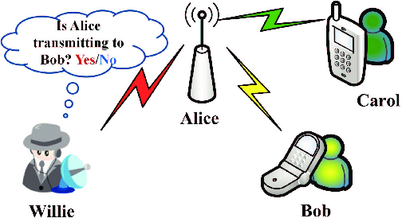
Motivations
Motivations Contributions
An approach of secure communications: Covert Communication
Need for Covert Communications
Combining cryptography and physical layer security can prevent eavesdropping
Covert communications are necessary to counter traffic analysis threats
Transmit data in a manner that avoids detection or suspicion
Covert Communication: Discovering Full-Duplex (FD) Systems
Full-Duplex (FD) Systems
Enable real-time bidirectional communication
Half-Duplex Systems
Cause delays, reduce efficiency
Advantage of FD in Covert Operations
Transmit covertly, appear as receiver, enhances stealth

Slide 4
Contributions
Motivations Contributions
Dissertation
Detection Error Probability Maximization for Disguised Full-Duplex Covert Communications
Enhancing Covert Communication System Performance
Overview
Our research enhances the covert communication performance
Covert Transmission
Covert transmissions to hidden receiver via an unseen antenna
Surveillance
Monitored by warden node for suspicious communication
Objectives
Optimization of public data rate and transmit power of FD destination node to maximize DEP
Prioritizing a minimum covert rate within the system

Slide 5
Outline
.
System model
Problem Formulation
Proposed Solution
Numerical results
Conclusion

Slide 6






System Model
System Model Problem Formulation Proposed Solution Numerical Result Conclusion
2. Schematic Diagram
Hidden Receiver, R
Covert Message
Self-interference
Source, S
Public Message
Disguised FD destination, D
Warden, W

Slide 7



System Model
System Model Problem Formulation Proposed Solution Numerical Result Conclusion
2.1 Received signals
At the disguised FD destination $D$
$y_{D}=h_{SD}\sqrt{P_{S}}x_{P}+{\tilde{h}}_{DD}\sqrt{P_{D}}x_{C}+z_{D}$
$x_{P}\sim CN\left(0,1\right)$: Public message
$x_{C}\sim CN\left(0,1\right)$: Covert message
$P_{S}$: Transmit power at the source
$P_{D}$: Transmit power at the covert FD destination
${\tilde{h}}_{DD}\sim CN\left(0,σ_{SI}^{2}\right)$: Residual self interference after self interference cancellation
Public Message,${ x}_{P}$
Covert Message, $x_{C}$
Disguised FD destination, D
Source, S

Slide 8



System Model
System Model Problem Formulation Proposed Solution Numerical Result Conclusion
2.1 Received Signals
At the disguised FD destination $D$
Channel capacity for the public message
${\bar{r}}_{P,D}=\log_{2}\left(1+\frac{{\left|h_{SD}\right|}^{2}P_{S}}{{\left|{\tilde{h}}_{DD}\right|}^{2}P_{D}+σ_{D}^{2}}\right)$
Adaptive transmission policy with rate $r_{P}≤{\overline{r}}_{P,D}$ assumed, based on the feedback from the destination
Public Message,$x_{P}$
Covert Message,$x_{C}$
Disguised FD destination, D
Source, S

Slide 9


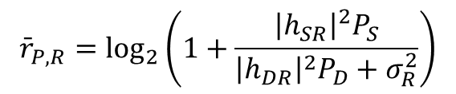


System Model
System Model Problem Formulation Proposed Solution Numerical Result Conclusion
2.1 Received signals
At the hidden receiver $R$
Channel capacity for the public message by treating the covert message as interference (if $r_{P}≤{\overline{r}}_{P,R}$)
$$y_{R}=h_{SR}\sqrt{P_{S}}x_{P}+h_{DR}\sqrt{P_{D}}x_{C}+z_{R}$$
$${\bar{r}}_{P,R}=\log_{2}\left(1+\frac{{\left|h_{SR}\right|}^{2}P_{S}}{{\left|h_{DR}\right|}^{2}P_{D}+σ_{R}^{2}}\right)$$
Public Message,${ x}_{P}$
Covert Message, $x_{C}$
Disguised FD destination, D
Source, S
Hidden
receiver, R

Slide 10

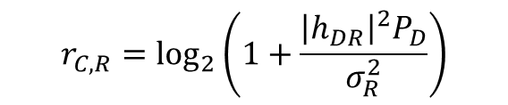
System Model
System Model Problem Formulation Proposed Solution Numerical Result Conclusion
2.1 Received signals
At the hidden receiver $R$
Achievable rate for the covert message after canceling the decoded public message
$$y_{R}=h_{SR}\sqrt{P_{S}}x_{P}+h_{DR}\sqrt{P_{D}}x_{C}+z_{R}$$
$$r_{C,R}=\log_{2}\left(1+\frac{{\left|h_{DR}\right|}^{2}P_{D}}{σ_{R}^{2}}\right)$$
Public Message,${ x}_{P}$
Covert Message, $x_{C}$
Disguised FD destination, D
Source, S
Hidden
receiver, R

Slide 11


System Model
System Model Problem Formulation Proposed Solution Numerical Result Conclusion
2.2 Covert Message Detection
At the warden $W$
Achievable rate for the covert message after canceling the decoded public message
$$y_{W}=h_{SW}\sqrt{P_{S}}x_{P}+h_{DW}\sqrt{P_{D}}x_{C}+z_{W}$$
$$r_{C,R}=\log_{2}\left(1+\frac{{\left|h_{DR}\right|}^{2}P_{D}}{σ_{R}^{2}}\right)$$
Public Message,${ x}_{P}$
Covert Message, $x_{C}$
Disguised FD destination, D
Source, S
Warden, W

Slide 12


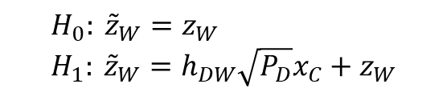

System Model
System Model Problem Formulation Proposed Solution Numerical Result Conclusion
2.2 Covert Message Detection
The worst-case assumption: $P_{D}$ known at the detector [HTa:20]
The effective residual signal assuming the warden successfully decoded $x_{P}$
The null and alternative hypotheses
The test statistics $T=E\left[{\left|{\tilde{z}}_{W}\right|}^{2}\right]$
$${\tilde{z}}_{W}≜y_{W}−h_{SW}\sqrt{P_{S}}x_{P}$$
$$H_{0}: {\tilde{z}}_{W}=z_{W} \\ H_{1}: {\tilde{z}}_{W}=h_{DW}\sqrt{P_{D}}x_{C}+z_{W}$$
$$H_{0}: T=σ_{W}^{2} \\ H_{1}: T={\left|h_{DW}\right|}^{2}P_{D}+σ_{W}^{2}$$

Slide 13

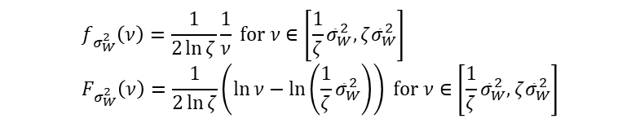
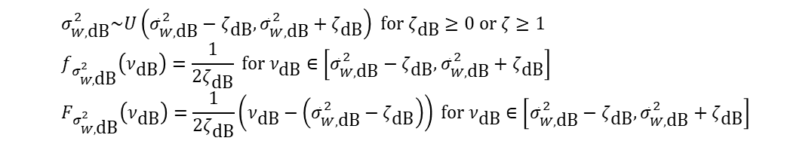
System Model
System Model Problem Formulation Proposed Solution Numerical Result Conclusion
2.2 Covert Message Detection
The worst-case assumption: $P_{D}$ known at the detector [HTa:20]
Noise uncertainty
Bounded uncertainty model with the mean noise power ${\overline{σ}}_{W,dB}^{2}$
By change of variables with $σ_{W,dB}^{2}=10\log_{10}{σ_{W}^{2}}$
$$σ_{W,\text{dB}}^{2}\sim U\left({\bar{σ}}_{W,\text{dB}}^{2}−ζ_{\text{dB}},{\bar{σ}}_{W,\text{dB}}^{2}+ζ_{\text{dB}}\right) \text{for} ζ_{\text{dB}}≥0 \text{or} ζ≥1 \\ f_{σ_{W,\text{dB}}^{2}}\left(ν_{\text{dB}}\right)=\frac{1}{2ζ_{\text{dB}}} \text{for} ν_{\text{dB}}∈\left[{\bar{σ}}_{W,\text{dB}}^{2}−ζ_{\text{dB}},{\bar{σ}}_{W,\text{dB}}^{2}+ζ_{\text{dB}}\right] \\ F_{σ_{W,\text{dB}}^{2}}\left(ν_{\text{dB}}\right)=\frac{1}{2ζ_{\text{dB}}}\left(ν_{\text{dB}}−\left({\bar{σ}}_{W,\text{dB}}^{2}−ζ_{\text{dB}}\right)\right) \text{for} ν_{\text{dB}}∈\left[{\bar{σ}}_{W,\text{dB}}^{2}−ζ_{\text{dB}},{\bar{σ}}_{W,\text{dB}}^{2}+ζ_{\text{dB}}\right]$$
$$f_{σ_{W}^{2}}\left(ν\right)=\frac{1}{2\ln{ζ}}\frac{1}{ν} \text{for} ν∈\left[\frac{1}{ζ}{\bar{σ}}_{W}^{2},ζ{\bar{σ}}_{W}^{2}\right] \\ F_{σ_{W}^{2}}\left(ν\right)=\frac{1}{2\ln{ζ}}\left(\ln{ν}−\ln\left(\frac{1}{ζ}{\bar{σ}}_{W}^{2}\right)\right) \text{for} ν∈\left[\frac{1}{ζ}{\bar{σ}}_{W}^{2},ζ{\bar{σ}}_{W}^{2}\right]$$

Slide 14

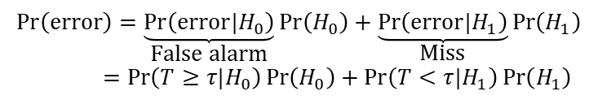

System Model
System Model Problem Formulation Proposed Solution Numerical Result Conclusion
2.2 Covert Message Detection
The worst-case assumption: $P_{D}$ known at the detector [HTa:20]
Noise uncertainty
Decision based on a threshold $τ$
Detection error probability (DEP)
False alarm probability
$$T\begin{matrix}\overset{H_{1}}{≥} \\ \underset{H_{0}}{<}\end{matrix}τ$$
$$\operatorname{Pr}\left(\text{error}\right)=\underset{\text{False} \text{alarm}}{\underbrace{\operatorname{Pr}\left(\text{error}|H_{0}\right)}}\operatorname{Pr}\left(H_{0}\right)+\underset{\text{Miss}}{\underbrace{\operatorname{Pr}\left(\text{error}|H_{1}\right)}}\operatorname{Pr}\left(H_{1}\right) \\ =\operatorname{Pr}\left(T≥τ|H_{0}\right)\operatorname{Pr}\left(H_{0}\right)+\operatorname{Pr}\left(T<τ|H_{1}\right)\operatorname{Pr}\left(H_{1}\right)$$
$$\operatorname{Pr}\left(T≥τ|H_{0}\right)=\operatorname{Pr}\left(σ_{W}^{2}≥τ\right)=1−F_{σ_{W}^{2}}\left(τ\right)=1−\frac{1}{2\ln{ζ}}\left(\ln{τ}−\ln\left(\frac{1}{ζ}{\bar{σ}}_{W}^{2}\right)\right) \text{for} τ∈\left[\frac{1}{ζ}{\bar{σ}}_{W}^{2},ζ{\bar{σ}}_{W}^{2}\right]$$

Slide 15

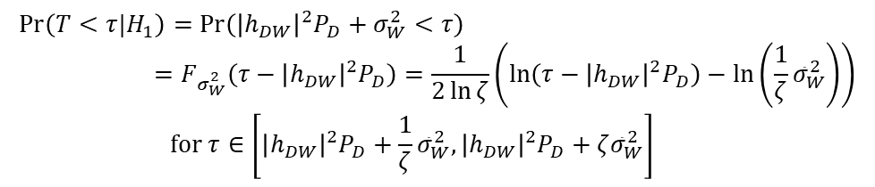


System Model
System Model Problem Formulation Proposed Solution Numerical Result Conclusion
2.2 Covert Message Detection
The worst-case assumption: $P_{D}$ known at the detector [HTa:20]
Noise uncertainty
Decision based on a threshold $τ$
Detection error probability (DEP)
Miss probability
$$T\begin{matrix}\overset{H_{1}}{≥} \\ \underset{H_{0}}{<}\end{matrix}τ$$
$$\operatorname{Pr}\left(\text{error}\right)=\underset{\text{False} \text{alarm}}{\underbrace{\operatorname{Pr}\left(\text{error}|H_{0}\right)}}\operatorname{Pr}\left(H_{0}\right)+\underset{\text{Miss}}{\underbrace{\operatorname{Pr}\left(\text{error}|H_{1}\right)}}\operatorname{Pr}\left(H_{1}\right) \\ =\operatorname{Pr}\left(T≥τ|H_{0}\right)\operatorname{Pr}\left(H_{0}\right)+\operatorname{Pr}\left(T<τ|H_{1}\right)\operatorname{Pr}\left(H_{1}\right)$$
$$\operatorname{Pr}\left(T<τ|H_{1}\right)=\operatorname{Pr}\left({\left|h_{DW}\right|}^{2}P_{D}+σ_{W}^{2}<τ\right) \\ =F_{σ_{W}^{2}}\left(τ−{\left|h_{DW}\right|}^{2}P_{D}\right)=\frac{1}{2\ln{ζ}}\left(\ln\left(τ−{\left|h_{DW}\right|}^{2}P_{D}\right)−\ln\left(\frac{1}{ζ}{\bar{σ}}_{W}^{2}\right)\right) \\ \text{for} τ∈\left[{\left|h_{DW}\right|}^{2}P_{D}+\frac{1}{ζ}{\bar{σ}}_{W}^{2},{\left|h_{DW}\right|}^{2}P_{D}+ζ{\bar{σ}}_{W}^{2}\right]$$

Slide 16



System Model
System Model Problem Formulation Proposed Solution Numerical Result Conclusion
2.2 Covert Message Detection
The worst-case assumption: $P_{D}$ known at the detector [HTa:20]
Noise uncertainty
Decision based on a threshold $τ$
Detection error probability (DEP)
Assuming the equally probable chance of the covert message, $\operatorname{Pr}\left(H_{0}\right)=\operatorname{Pr}\left(H_{1}\right)=\frac{1}{2}$
$$T\begin{matrix}\overset{H_{1}}{≥} \\ \underset{H_{0}}{<}\end{matrix}τ$$
$$① ζ{\bar{σ}}_{W}^{2}<{\left|h_{DW}\right|}^{2}P_{D}+\frac{1}{ζ}{\bar{σ}}_{W}^{2} \\ \operatorname{Pr}\left(\text{error}\right)=\left\{\begin{matrix}\frac{1}{2}\operatorname{Pr}\left(T≥τ|H_{0}\right) & , τ∈\left[\frac{1}{ζ}{\bar{σ}}_{W}^{2},ζ{\bar{σ}}_{W}^{2}\right] \\ 0 & , τ∈\left[ζ{\bar{σ}}_{W}^{2},{\left|h_{DW}\right|}^{2}P_{D}+\frac{1}{ζ}{\bar{σ}}_{W}^{2}\right] \\ \frac{1}{2}\operatorname{Pr}\left(T<τ|H_{1}\right) & , τ∈\left[{\left|h_{DW}\right|}^{2}P_{D}+\frac{1}{ζ}{\bar{σ}}_{W}^{2},{\left|h_{DW}\right|}^{2}P_{D}+ζ{\bar{σ}}_{W}^{2}\right]\end{matrix}\right.$$

Slide 17


System Model
System Model Problem Formulation Proposed Solution Numerical Result Conclusion
2.2 Covert Message Detection
The worst-case assumption: $P_{D}$ known at the detector [HTa:20]
Noise uncertainty
Decision based on a threshold $τ$
Detection error probability (DEP)
Assuming the equally probable chance of the covert message, $\operatorname{Pr}\left(H_{0}\right)=\operatorname{Pr}\left(H_{1}\right)=\frac{1}{2}$
$$T\begin{matrix}\overset{H_{1}}{≥} \\ \underset{H_{0}}{<}\end{matrix}τ$$
$$② ζ{\bar{σ}}_{W}^{2}≥{\left|h_{DW}\right|}^{2}P_{D}+\frac{1}{ζ}{\bar{σ}}_{W}^{2} \\ \operatorname{Pr}\left(\text{error}\right)=\left\{\begin{matrix}\frac{1}{2}\operatorname{Pr}\left(T≥τ|H_{0}\right) & , τ∈\left[\frac{1}{ζ}{\bar{σ}}_{W}^{2},{\left|h_{DW}\right|}^{2}P_{D}+\frac{1}{ζ}{\bar{σ}}_{W}^{2}\right] \\ \frac{1}{2}\left(\operatorname{Pr}\left(T≥τ|H_{0}\right)+\operatorname{Pr}\left(T<τ|H_{1}\right)\right) & , τ∈\left[{\left|h_{DW}\right|}^{2}P_{D}+\frac{1}{ζ}{\bar{σ}}_{W}^{2},ζ{\bar{σ}}_{W}^{2}\right] \\ \frac{1}{2}\operatorname{Pr}\left(T<τ|H_{1}\right) & , τ∈\left[ζ{\bar{σ}}_{W}^{2},{\left|h_{DW}\right|}^{2}P_{D}+ζ{\bar{σ}}_{W}^{2}\right]\end{matrix}\right.$$

Slide 18








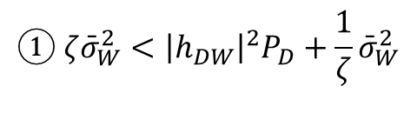

System Model
System Model Problem Formulation Proposed Solution Numerical Result Conclusion
2.2 Covert Message Detection
The worst-case assumption: $P_{D}$ known at the detector [HTa:20]
The shape of the DEP function
$$① ζ{\bar{σ}}_{W}^{2}<{\left|h_{DW}\right|}^{2}P_{D}+\frac{1}{ζ}{\bar{σ}}_{W}^{2}$$
$$Pr⁡(error)$$
$$\frac{1}{2}$$
Maximum error
= A random guess
$$0$$
False alarm
Miss detection
$$0$$
$$\frac{1}{ζ}{\bar{σ}}_{W}^{2}$$
$${\left|h_{DW}\right|}^{2}P_{D}+\frac{1}{ζ}{\bar{σ}}_{W}^{2}$$
$${\left|h_{DW}\right|}^{2}P_{D}+ζ{\bar{σ}}_{W}^{2}$$
$$ζ{\bar{σ}}_{W}^{2}$$

Slide 19

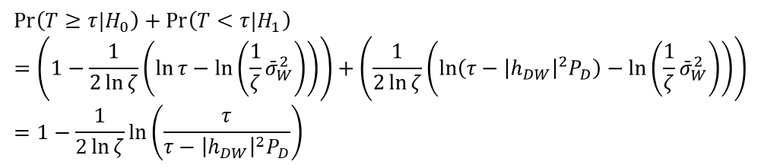
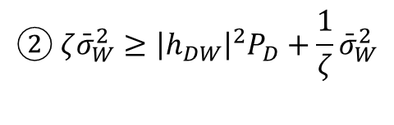
System Model
System Model Problem Formulation Proposed Solution Numerical Result Conclusion
2.2 Covert Message Detection
The worst-case assumption: $P_{D}$ known at the detector [HTa:20]
The shape of the DEP function
Note that
The first derivative
$$② ζ{\bar{σ}}_{W}^{2}≥{\left|h_{DW}\right|}^{2}P_{D}+\frac{1}{ζ}{\bar{σ}}_{W}^{2}$$
$$\operatorname{Pr}\left(T≥τ|H_{0}\right)+\operatorname{Pr}\left(T<τ|H_{1}\right) \\ =\left(1−\frac{1}{2\ln{ζ}}\left(\ln{τ}−\ln\left(\frac{1}{ζ}{\bar{σ}}_{W}^{2}\right)\right)\right)+\left(\frac{1}{2\ln{ζ}}\left(\ln\left(τ−{\left|h_{DW}\right|}^{2}P_{D}\right)−\ln\left(\frac{1}{ζ}{\bar{σ}}_{W}^{2}\right)\right)\right) \\ =1−\frac{1}{2\ln{ζ}}\ln\left(\frac{τ}{τ−{\left|h_{DW}\right|}^{2}P_{D}}\right)$$
$$\frac{∂}{∂τ}\left(\operatorname{Pr}\left(T≥τ|H_{0}\right)+\operatorname{Pr}\left(T<τ|H_{1}\right)\right)=\frac{1}{2\ln{ζ}}\frac{{\left|h_{DW}\right|}^{2}P_{D}}{τ\left(τ−{\left|h_{DW}\right|}^{2}P_{D}\right)} ⇒ \text{Increasing} \text{for} τ≥{\left|h_{DW}\right|}^{2}P_{D}$$

Slide 20



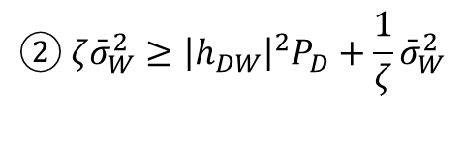
System Model
System Model Problem Formulation Proposed Solution Numerical Result Conclusion
2.2 Covert Message Detection
The worst-case assumption: $P_{D}$ known at the detector [HTa:20]
The shape of the DEP function
$$② ζ{\bar{σ}}_{W}^{2}≥{\left|h_{DW}\right|}^{2}P_{D}+\frac{1}{ζ}{\bar{σ}}_{W}^{2}$$
$$Pr⁡(error)$$
$$\frac{1}{2}$$
$$\frac{1}{2}\operatorname{Pr}\left(T≥τ|H_{0}\right) \\ +\frac{1}{2}\operatorname{Pr}\left(T<τ|H_{1}\right)$$
Maximum error
= A random guess
False alarm
Miss detection
$$0$$
$$0$$
$$\frac{1}{ζ}{\bar{σ}}_{W}^{2}$$
$${\left|h_{DW}\right|}^{2}P_{D}+\frac{1}{ζ}{\bar{σ}}_{W}^{2}$$
$$ζ{\bar{σ}}_{W}^{2}$$
$${\left|h_{DW}\right|}^{2}P_{D}+ζ{\bar{σ}}_{W}^{2}$$

Slide 21

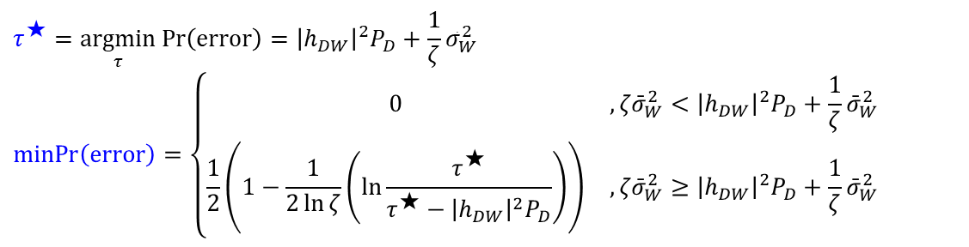
System Model
System Model Problem Formulation Proposed Solution Numerical Result Conclusion
2.2 Covert Message Detection
The worst-case assumption: $P_{D}$ known at the detector [HTa:20]
The minimum DEP and the optimal threshold $τ^{⋆}$
$$τ^{★}=\underset{τ}{argmin}\operatorname{Pr}\left(\text{error}\right)={\left|h_{DW}\right|}^{2}P_{D}+\frac{1}{ζ}{\bar{σ}}_{W}^{2} \\ \operatorname{minPr}\left(\text{error}\right)=\left\{\begin{matrix}0 & , ζ{\bar{σ}}_{W}^{2}<{\left|h_{DW}\right|}^{2}P_{D}+\frac{1}{ζ}{\bar{σ}}_{W}^{2} \\ \frac{1}{2}\left(1−\frac{1}{2\ln{ζ}}\left(\ln{\frac{τ^{★}}{τ^{★}−{\left|h_{DW}\right|}^{2}P_{D}}}\right)\right) & , ζ{\bar{σ}}_{W}^{2}≥{\left|h_{DW}\right|}^{2}P_{D}+\frac{1}{ζ}{\bar{σ}}_{W}^{2}\end{matrix}\right.$$

Slide 22
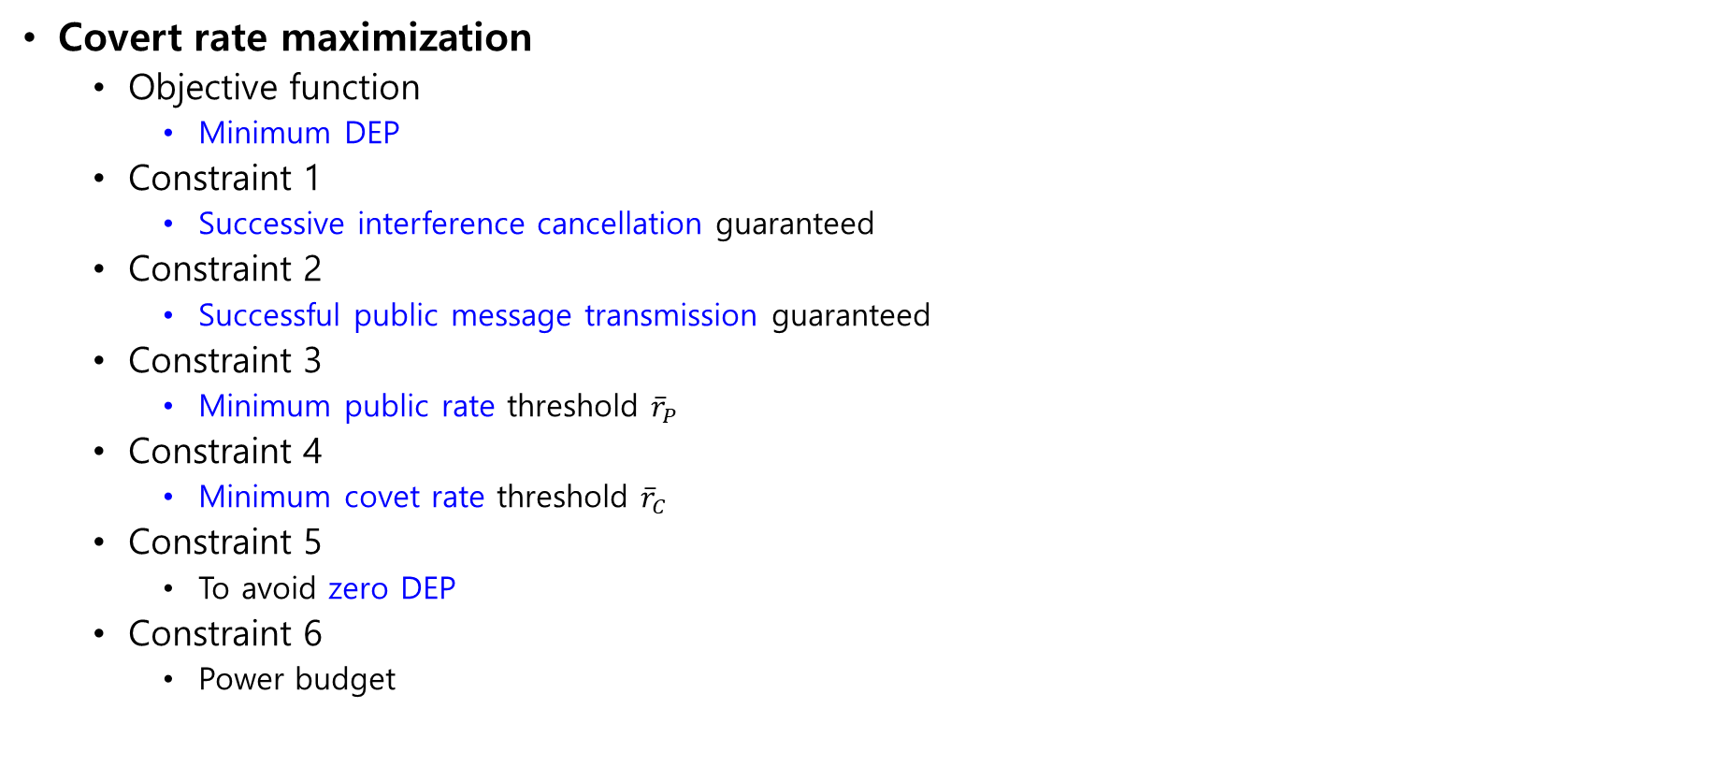

Problem Formulation
System Model Problem Formulation Proposed Solution Numerical Result Conclusion
Covert rate maximization
Objective function
Minimum DEP
Constraint 1
Successive interference cancellation guaranteed
Constraint 2
Successful public message transmission guaranteed
Constraint 3
Minimum public rate threshold ${\overline{r}}_{P}$
Constraint 4
Minimum covet rate threshold ${\overline{r}}_{C}$
Constraint 5
To avoid zero DEP
Constraint 6
Power budget
$$\text{P}\text{1})\text{: }\max_{P_{D},r_{P}} \operatorname{minPr}\left(\text{error}\right) \\ \text{subject} \text{to} r_{P}≤{\bar{r}}_{P,R} \\ r_{P}≤{\bar{r}}_{P,D} \\ r_{P}≥{\bar{r}}_{P} \\ { r}_{C,R}≥{\bar{r}}_{C} \\ ζ{\bar{σ}}_{W}^{2}≥{\left|h_{DW}\right|}^{2}P_{D}+\frac{1}{ζ}{\bar{σ}}_{W}^{2} \\ 0≤P_{D}≤{\bar{P}}_{D}$$

Slide 23

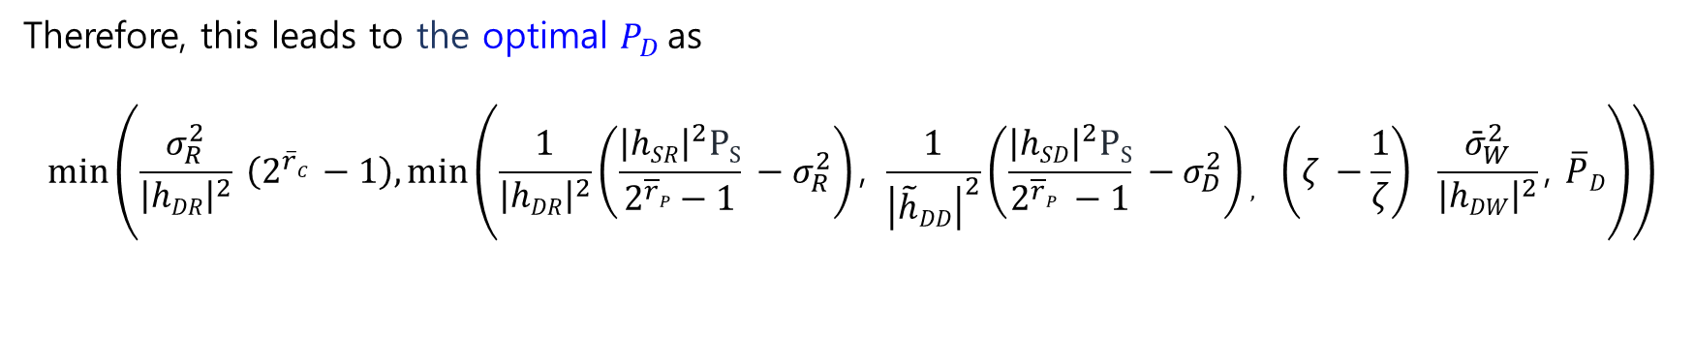
Proposed Solution
System Model Problem Formulation Proposed Solution Numerical Result Conclusion
Covert rate maximization
$P1.1):$ $\min_{P_{D}}{P_{D}}$
Subject to :$PD≤\frac{1}{{\left|hDR\right|}^{2}}\left(\frac{{\left|hSR\right|}^{2}PS}{2^{\overline{r}P} −1} −σ_{R}^{2}\right)$
$PD≤\frac{1}{{\left|\tilde{h}DD\right|}^{2}}\left(\frac{{\left|hSD\right|}^{2}PS}{2^{\overline{r}P} −1} −σ_{D}^{2}\right)$
$PD≥\frac{σ_{R}^{2}}{{\left|hDR\right|}^{2}} (2^{{\overline{r}}_{C}}−1)$
$PD≤\left(ζ −\frac{1}{ζ}\right)$ $\frac{{\bar{σ}}_{W}^{2}}{{\left|hDW\right|}^{2}}$
$0≤P_{D}≤ \overline{P}D$
Therefore, this leads to the optimal $P_{D}$as
$$\min\left(\frac{σ_{R}^{2}}{{\left|hDR\right|}^{2}} \left(2^{\overline{r}C} −1\right),\min\left(\frac{1}{{\left|hDR\right|}^{2}}\left(\frac{{\left|hSR\right|}^{2}PS}{2^{\overline{r}P}−1} −σ_{R}^{2}\right)\text{, }\frac{1}{{\left|\tilde{h}DD\right|}^{2}}\left(\frac{{\left|hSD\right|}^{2}PS}{2^{\overline{r}P} −1} −σ_{D}^{2}\right), \left(ζ −\frac{1}{ζ}\right) \frac{{\bar{σ}}_{W}^{2}}{{\left|hDW\right|}^{2}}\text{, }\overline{P}D\right)\right)$$

Slide 24
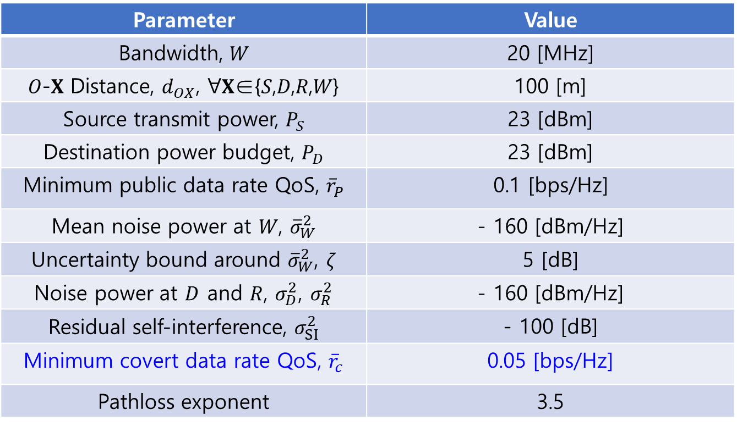
Numerical Result
System Model Problem Formulation Proposed Solution Numerical Result Conclusion
System Parameter
Parameter | Value
Bandwidth, 𝑊 | 20 [MHz]
𝑂-𝐗 Distance, $d_{OX}$, ∀𝐗∈{𝑆,𝐷,𝑅,𝑊} | 100 [m]
Source transmit power, $P_{S}$ | 23 [dBm]
Destination power budget, $P_{D}$ | 23 [dBm]
Minimum public data rate QoS, ${\overline{r}}_{P}$ | 0.1 [bps/Hz]
Mean noise power at 𝑊, ${\overline{σ}}_{W}^{2}$ | - 160 [dBm/Hz]
Uncertainty bound around ${\overline{σ}}_{W}^{2}$, $ζ$ | 5 [dB]
Noise power at $D$ and $R$, $σ_{D}^{2}$, $σ_{R}^{2}$ | - 160 [dBm/Hz]
Residual self-interference, $σ_{SI}^{2}$ | - 100 [dB]
Minimum covert data rate QoS, ${\overline{r}}_{c}$ | 0.05 [bps/Hz]
Pathloss exponent | 3.5

Slide 25
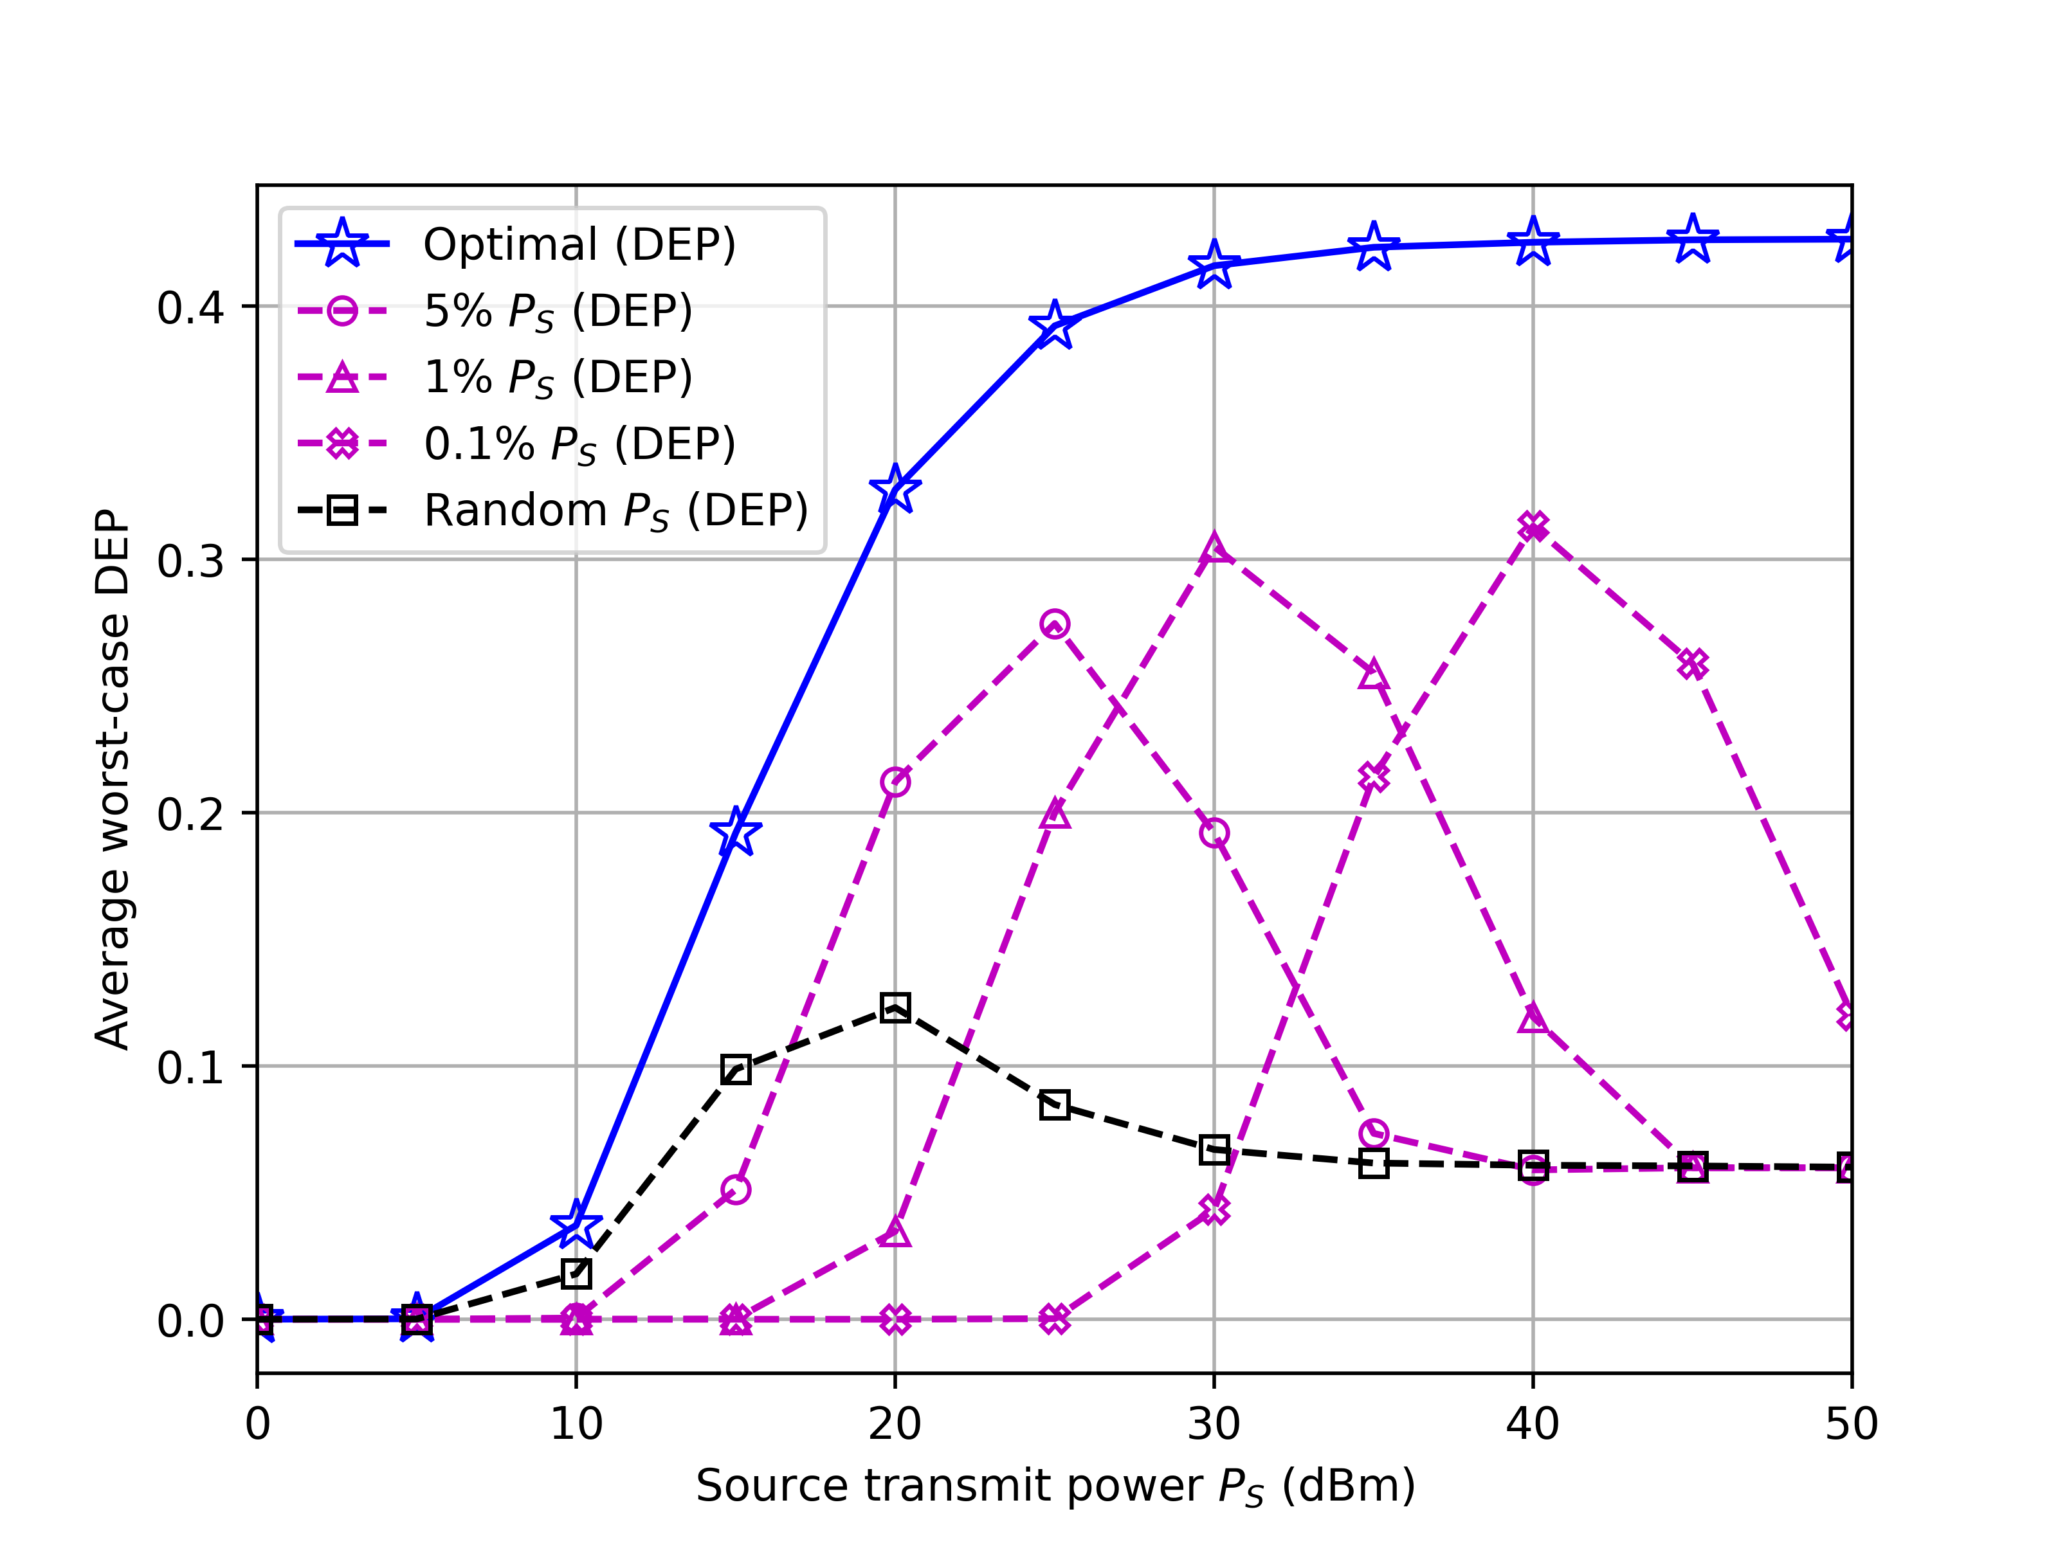

Numerical Result
System Model Problem Formulation Proposed Solution Numerical Result Conclusion
DEP vs. Source transmit power, $P_{S}$
The destination transmit power $P_{D}$ must be significantly lower than $P_{S}$ to ensure covertness.
Higher $P_{D}$ increases worst-case DEP when $P_{S}$ is low, while lower $P_{D}$ is preferred when $P_{S}$ is high.

Slide 26
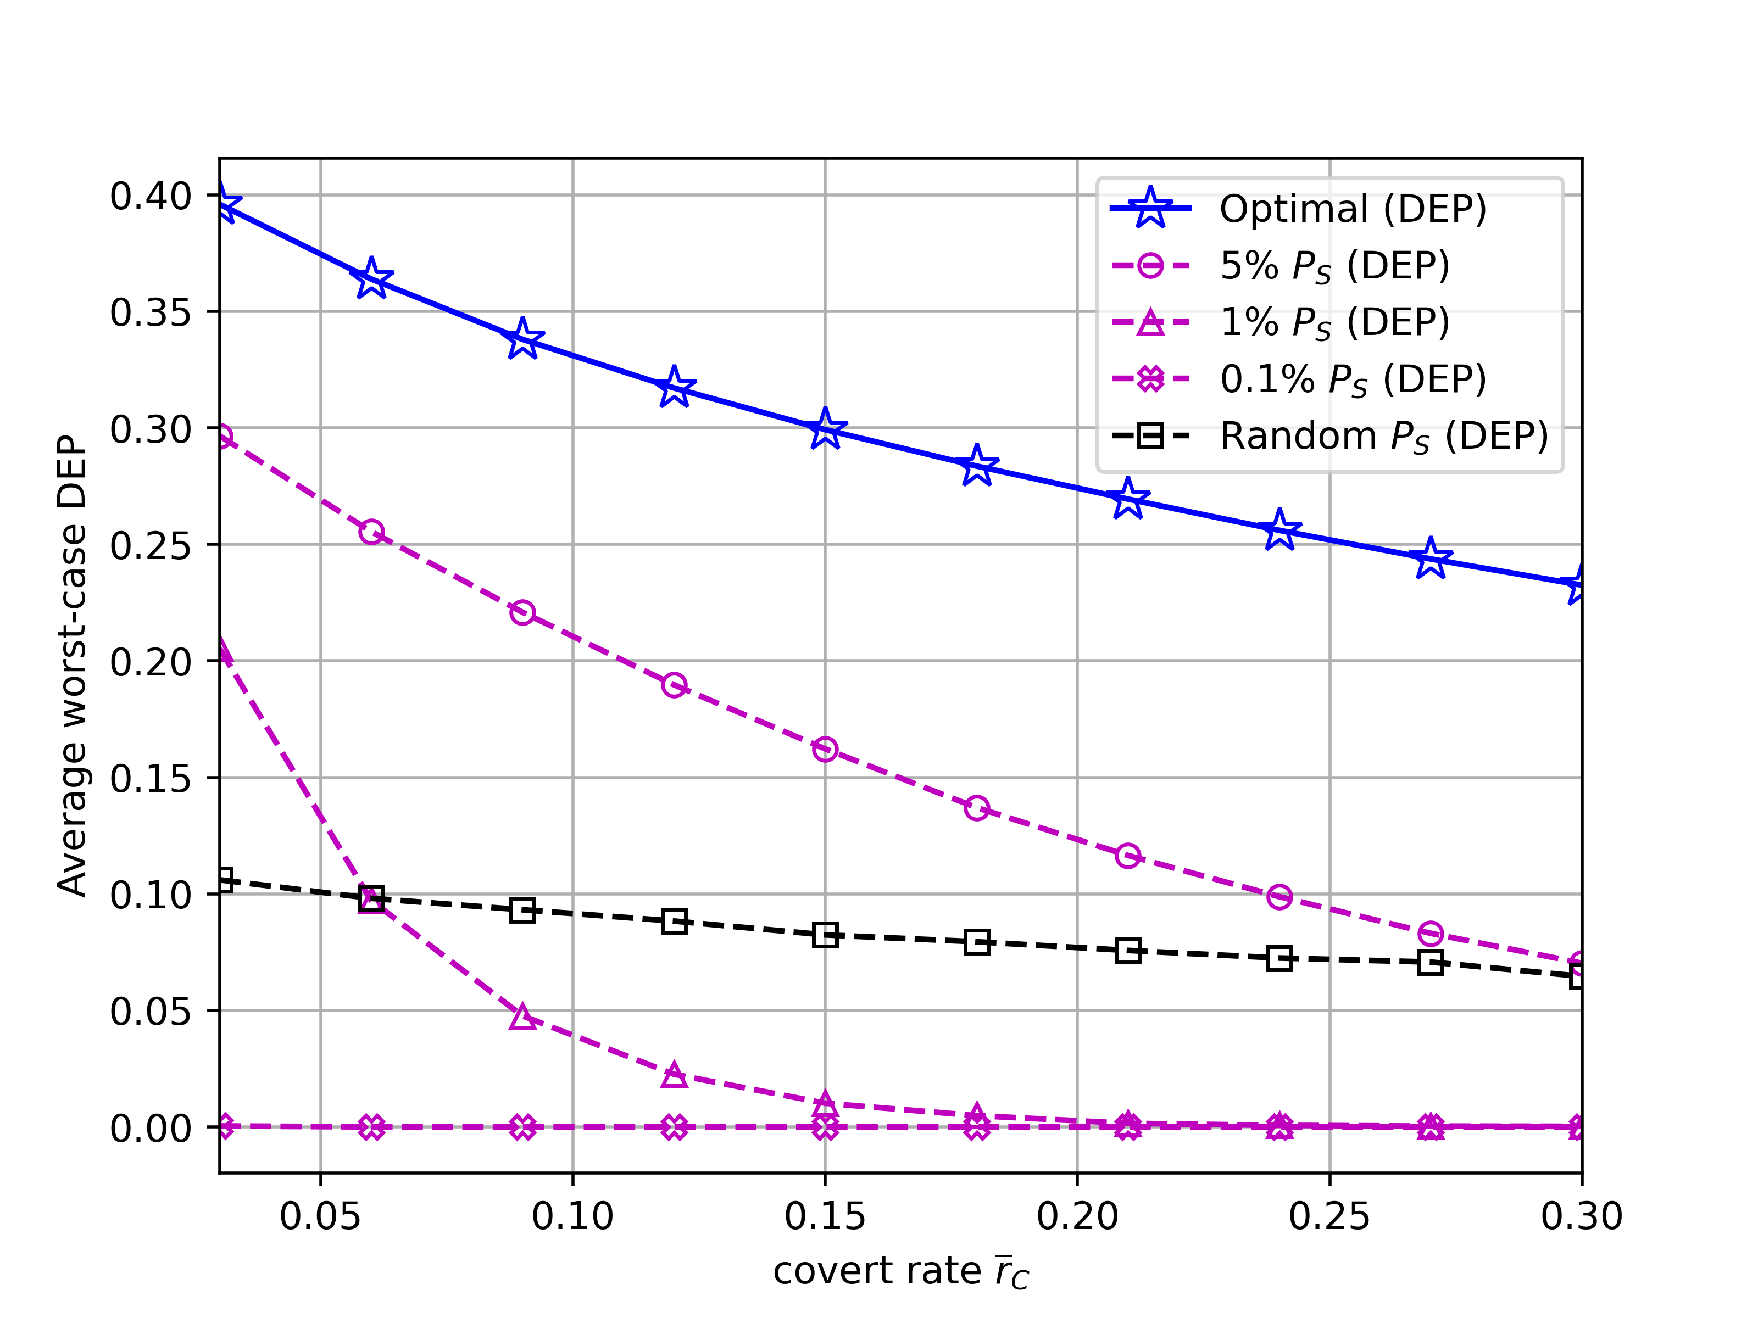

Numerical Result
System Model Problem Formulation Proposed Solution Numerical Result Conclusion
DEP vs. Minimum covert rate threshold,${\overline{r}}_{c}$
Higher ${\overline{r}}_{C}$ requires higher $P_{D}$,decreasing DEP.
"5% $P_{S}$" and random $P_{D}$ schemes perform comparatively better than any other scheme.

Slide 27
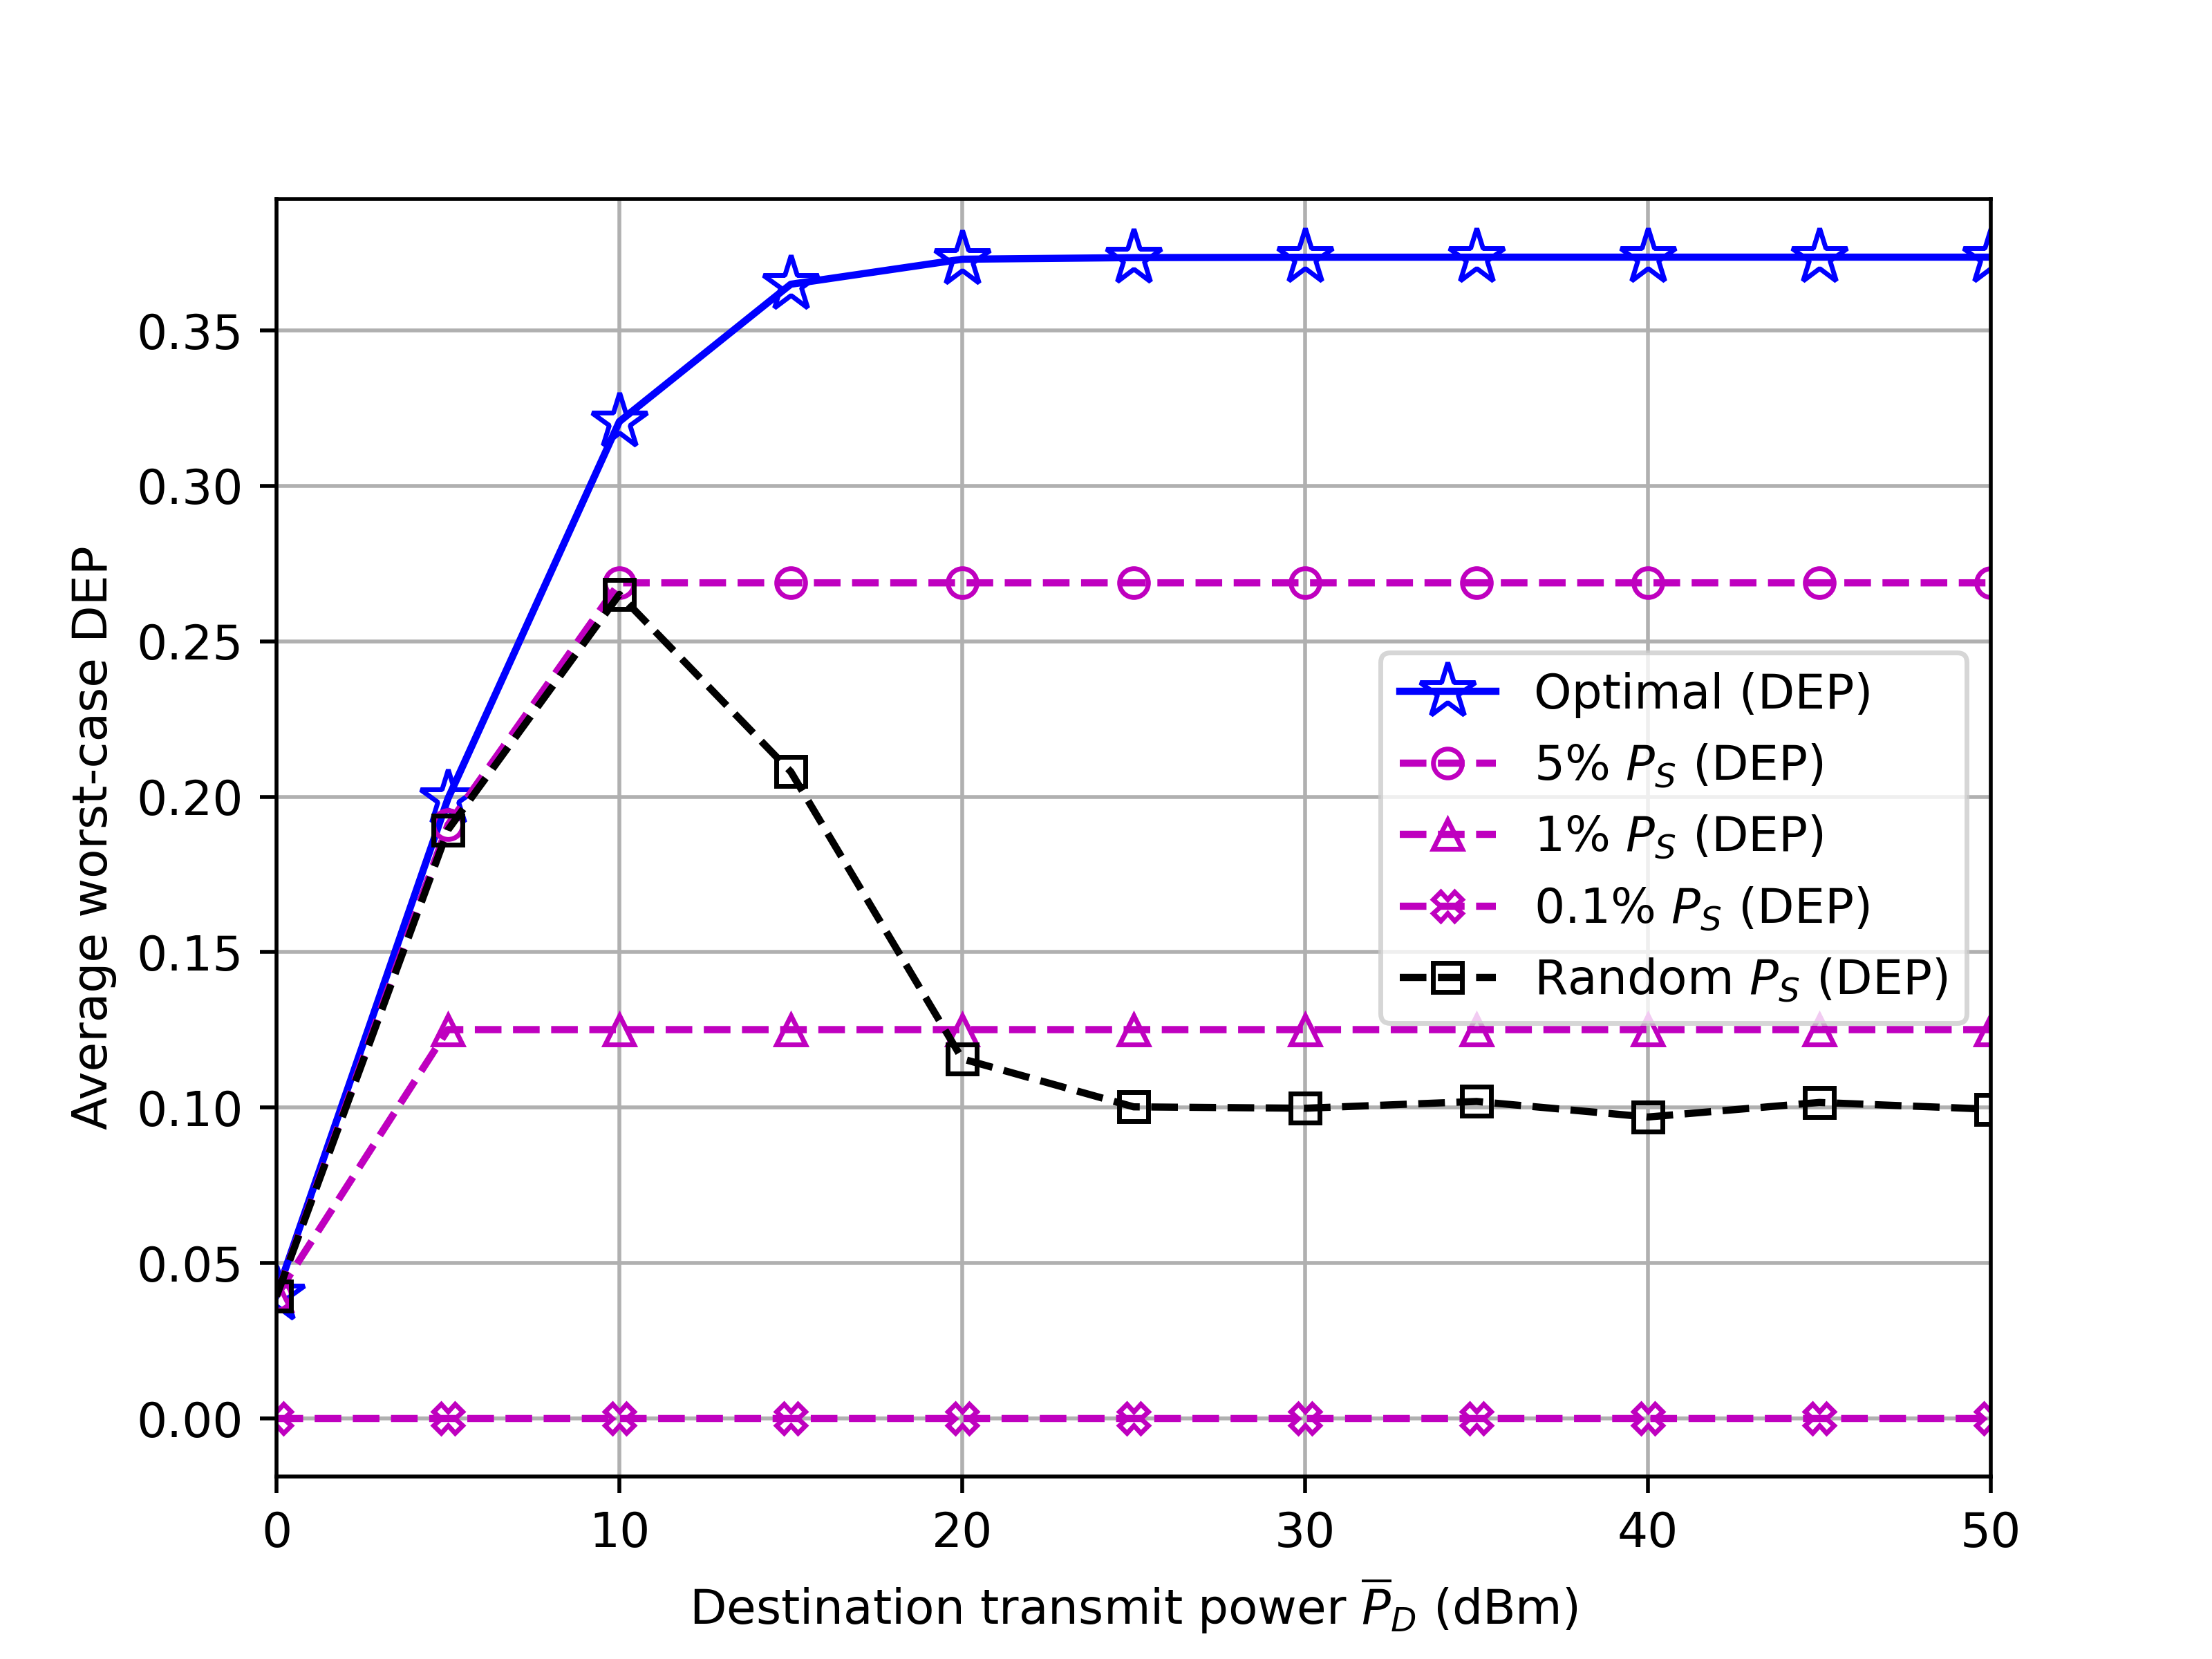

Numerical Result
System Model Problem Formulation Proposed Solution Numerical Result Conclusion
DEP vs. Destination transmit power budget, ${\overline{P}}_{D}$
When $P_{D}$ is low, both the "5% $P_{S}$" and random $P_{D}$ schemes demonstrate performance close to the optimal scheme.
This closeness in performance arises because the influence of $P_{D}^{∗}$ is dominant in this range by ${\overline{P}}_{D}$.

Slide 28
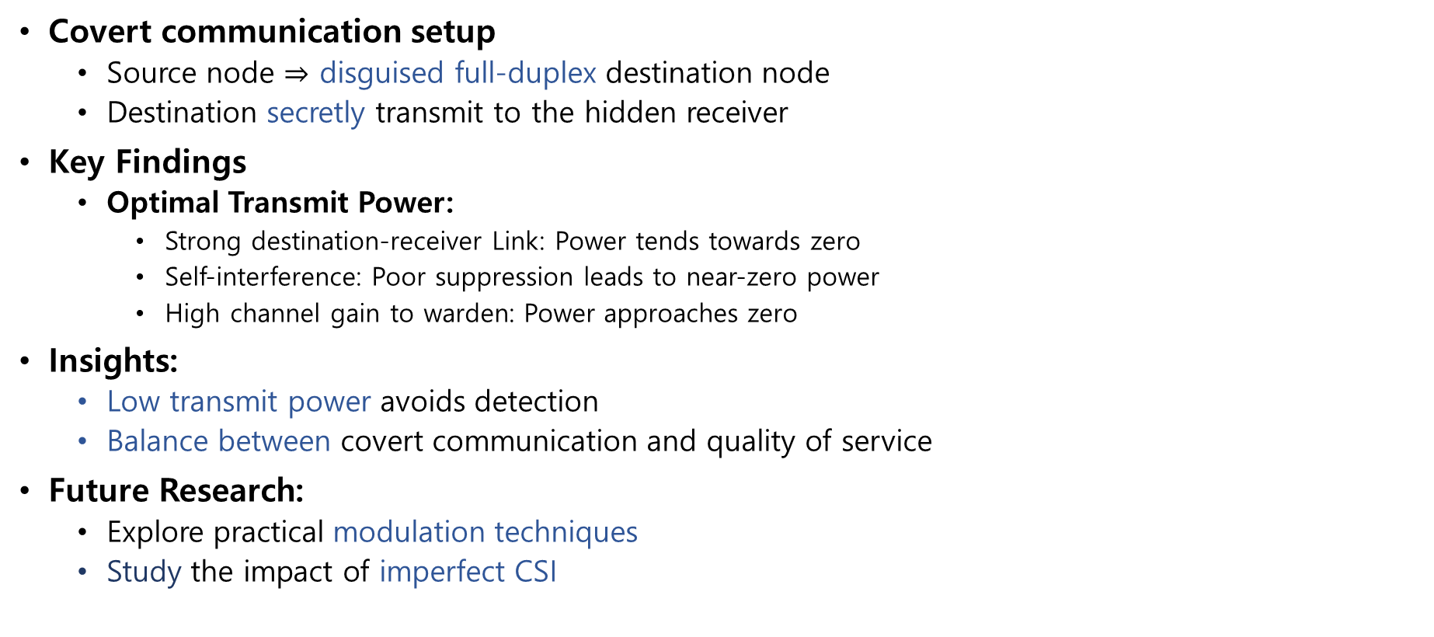
Conclusion
System Model Problem Formulation Proposed Solution Numerical Result Conclusion
Covert communication setup
Source node $⇒$ disguised full-duplex destination node
Destination secretly transmit to the hidden receiver
Key Findings
Optimal Transmit Power:
Strong destination-receiver Link: Power tends towards zero
Self-interference: Poor suppression leads to near-zero power
High channel gain to warden: Power approaches zero
Insights:
Low transmit power avoids detection
Balance between covert communication and quality of service
Future Research:
Explore practical modulation techniques
Study the impact of imperfect CSI

Slide 30




Is Alice transmitting to Bob? Yes/No

